Slide 1

TM112
Argument Mapping
Introduction to
Computing & IT 2

Slide 2
Argument Mapping
Argument mapping
Shows the structure of an argument visually
Helps you evaluate what you are being told
Helps you decide whether to accept or reject a claim
Why use argument mapping?
Argument mapping will help you
Develop your general reasoning and critical thinking
Provide clear, strong and well-organised arguments
Communicate your reasoning
Evaluate your reasoning
Resolve disagreements rationally
Make better decisions

Slide 3
Why do we need to evaluate arguments?
Understanding the point being made
Understanding the evidence supporting that point
Understanding why some evidence is discarded in an argument
Some evidence supporting the idea argument mapping can improve critical thinking ability (Alvarez, 2007)
There are risks in accepting a viewpoint as fact.
“Fake news”
Conspiracy theories
Biased research

Slide 4
Argument mapping process
Argument maps have a defined structure and there is an algorithm for creating them.
Identify the main claim in a text.
Find text with claims supporting the main claim and texts opposing the main claim
Repeat the previous step to find texts supporting or opposing each sub claim.
A claim can be supported or opposed by one or more claims either individually or as a group.
This is reflected in the way claims are linked together in the argument map.
You should be able to read and understand each claim on its own. You might need to rephrase them to stand alone.

Slide 5
Argument Mapping Process
You can use either a text-based approach or you can use a graphical approach.
Using either approach, start by identifying the main claim, call this Level 0
Then find text that supports that claim or opposes that claim and call this level 1
Next find text that supports or opposes your level 1 claims and call those level 2
Carry on until you have all your claims identified and then organize them.
A question then, does eating carrots improve your eyesight?

Slide 6
Carrots improve your eyesight!
Eating carrots improves your eyesight.
THE FACTS Your mother probably told you that carrots are good for your eyes - and you probably dismissed it as just an old wives' tale. But the claim is not baseless.
Carrots are high in beta carotene, a component of vitamin A, which is critical to normal vision. It's no coincidence that in countries where rice is a dietary staple, but carrots and other sources of the vitamin are scarce, poor vision is rampant.
So, should you forget about glasses and just eat carrots? Probably not. Studies show that while taking vitamin A can reverse poor vision caused by a deficiency, it will not strengthen eyesight or slow decline in people who are healthy.
A study by researchers at Johns Hopkins in 1998, for example, looked at 30,000 women in South Asia at high risk of vitamin deficiencies. It found that a group that received vitamin A tablets had 67 percent fewer cases of night blindness than a group that received a placebo.
But in 2003, researchers at Brigham and Women's Hospital in Boston found that a group of thousands of healthy men who took beta carotene pills for 12 years had the same rate of age-related cataracts as those given a placebo.
THE BOTTOM LINE Eating carrots helps maintain normal vision.
Anahad O’Connor, New York Times

Slide 7
Identify the main claim.
Eating carrots improves your eyesight.
THE FACTS Your mother probably told you that carrots are good for your eyes - and you probably dismissed it as just an old wives' tale. But the claim is not baseless.
Carrots are high in beta carotene, a component of vitamin A, which is critical to normal vision. It's no coincidence that in countries where rice is a dietary staple, but carrots and other sources of the vitamin are scarce, poor vision is rampant.
So, should you forget about glasses and just eat carrots? Probably not. Studies show that while taking vitamin A can reverse poor vision caused by a deficiency, it will not strengthen eyesight or slow decline in people who are healthy.
A study by researchers at Johns Hopkins in 1998, for example, looked at 30,000 women in South Asia at high risk of vitamin deficiencies. It found that a group that received vitamin A tablets had 67 percent fewer cases of night blindness than a group that received a placebo.
But in 2003, researchers at Brigham and Women's Hospital in Boston found that a group of thousands of healthy men who took beta carotene pills for 12 years had the same rate of age-related cataracts as those given a placebo.
THE BOTTOM LINE Eating carrots helps maintain normal vision.
Anahad O’Connor, New York Times

Slide 8
Identify supporting text at level 1.
Eating carrots improves your eyesight.
THE FACTS Your mother probably told you that carrots are good for your eyes - and you probably dismissed it as just an old wives' tale. But the claim is not baseless.
Carrots are high in beta carotene, a component of vitamin A, which is critical to normal vision. It's no coincidence that in countries where rice is a dietary staple, but carrots and other sources of the vitamin are scarce, poor vision is rampant.
So, should you forget about glasses and just eat carrots? Probably not. Studies show that while taking vitamin A can reverse poor vision caused by a deficiency, it will not strengthen eyesight or slow decline in people who are healthy.
A study by researchers at Johns Hopkins in 1998, for example, looked at 30,000 women in South Asia at high risk of vitamin deficiencies. It found that a group that received vitamin A tablets had 67 percent fewer cases of night blindness than a group that received a placebo.
But in 2003, researchers at Brigham and Women's Hospital in Boston found that a group of thousands of healthy men who took beta carotene pills for 12 years had the same rate of age-related cataracts as those given a placebo.
THE BOTTOM LINE Eating carrots helps maintain normal vision.
Anahad O’Connor, New York Times

Slide 9
Identify opposing text at level 1.
Eating carrots improves your eyesight.
THE FACTS Your mother probably told you that carrots are good for your eyes - and you probably dismissed it as just an old wives' tale. But the claim is not baseless.
Carrots are high in beta carotene, a component of vitamin A, which is critical to normal vision. It's no coincidence that in countries where rice is a dietary staple, but carrots and other sources of the vitamin are scarce, poor vision is rampant.
So, should you forget about glasses and just eat carrots? Probably not. Studies show that while taking vitamin A can reverse poor vision caused by a deficiency, it will not strengthen eyesight or slow decline in people who are healthy.
A study by researchers at Johns Hopkins in 1998, for example, looked at 30,000 women in South Asia at high risk of vitamin deficiencies. It found that a group that received vitamin A tablets had 67 percent fewer cases of night blindness than a group that received a placebo.
But in 2003, researchers at Brigham and Women's Hospital in Boston found that a group of thousands of healthy men who took beta carotene pills for 12 years had the same rate of age-related cataracts as those given a placebo.
THE BOTTOM LINE Eating carrots helps maintain normal vision.
Anahad O’Connor, New York Times
Note that the beta carotene content appears in both support and oppose here. This is because the clams are going to be grouped.

Slide 10
Identify text that supports supporting level 1 claims.
Eating carrots improves your eyesight.
THE FACTS Your mother probably told you that carrots are good for your eyes - and you probably dismissed it as just an old wives' tale. But the claim is not baseless.
Carrots are high in beta carotene, a component of vitamin A, which is critical to normal vision. It's no coincidence that in countries where rice is a dietary staple, but carrots and other sources of the vitamin are scarce, poor vision is rampant.
So, should you forget about glasses and just eat carrots? Probably not. Studies show that while taking vitamin A can reverse poor vision caused by a deficiency, it will not strengthen eyesight or slow decline in people who are healthy.
A study by researchers at Johns Hopkins in 1998, for example, looked at 30,000 women in South Asia at high risk of vitamin deficiencies. It found that a group that received vitamin A tablets had 67 percent fewer cases of night blindness than a group that received a placebo. (This supports the claim that taking vitamin A can reverse poor vision)
But in 2003, researchers at Brigham and Women's Hospital in Boston found that a group of thousands of healthy men who took beta carotene pills for 12 years had the same rate of age-related cataracts as those given a placebo.
THE BOTTOM LINE Eating carrots helps maintain normal vision.
Anahad O’Connor, New York Times

Slide 11
Identify text that supports opposing level 1 claims.
Eating carrots improves your eyesight.
THE FACTS Your mother probably told you that carrots are good for your eyes - and you probably dismissed it as just an old wives' tale. But the claim is not baseless.
Carrots are high in beta carotene, a component of vitamin A, which is critical to normal vision. It's no coincidence that in countries where rice is a dietary staple, but carrots and other sources of the vitamin are scarce, poor vision is rampant.
So, should you forget about glasses and just eat carrots? Probably not. Studies show that while taking vitamin A can reverse poor vision caused by a deficiency, it will not strengthen eyesight or slow decline in people who are healthy.
A study by researchers at Johns Hopkins in 1998, for example, looked at 30,000 women in South Asia at high risk of vitamin deficiencies. It found that a group that received vitamin A tablets had 67 percent fewer cases of night blindness than a group that received a placebo.
But in 2003, researchers at Brigham and Women's Hospital in Boston found that a group of thousands of healthy men who took beta carotene pills for 12 years had the same rate of age-related cataracts as those given a placebo.
THE BOTTOM LINE Eating carrots helps maintain normal vision.
Anahad O’Connor, New York Times
Note that the beta carotene content appears in both support and oppose here. This is because the clams are going to be grouped.

Slide 12
Mapping the arguments - text
Level 0 – Eating Carrots improves your eyesight
Level 1 Support – Carrots are high in beta carotene a component of vitamin A
Level 1 Support - Taking vitamin A can reverse poor vision caused by a deficiency
Level 2 Support - A study by researchers at Johns Hopkins in 1998, for example, looked at 30,000 women in South Asia at high risk of vitamin deficiencies. It found that a group that received vitamin A tablets had 67 percent fewer cases of night blindness than a group that received a placebo.
Level 1 Oppose - Carrots are high in beta carotene a component of vitamin A
Level 1 Oppose - Vitamin A will not strengthen eyesight or slow decline in people who are healthy.
Level 2 Support - In 2003, researchers at Brigham and Women's Hospital in Boston found that a group of thousands of healthy men who took beta carotene pills for 12 years had the same rate of age-related cataracts as those given a placebo.
We can summarise the article by saying while vitamin A will see an improvement in the eyesight of those suffering vision issues due to vitamin A deficiency, It will not improve the eyesight of individuals who are not deficient in the vitamin.

Slide 13
Mapping the arguments - graphical
The OU supports the use of Freemind as a mind mapping tool.
You can also use Word, Powerpoint, Excel, Lucidchart, in fact any software that will draw a square or shape.
You can get help on Freemind from http://freemind.sourceforge.net/wiki/index.php/Documentation
You can draw freehand and submit a picture of your mind map. Remember a JPG copy as well in your submission.

Slide 14

Mapping the arguments - graphical
The OU supports the use of Freemind as a mind mapping tool.
You can also use Word, Powerpoint, Excel, Lucidchart, in fact any software that will draw a square or shape.
You can get help on Freemind from http://freemind.sourceforge.net/wiki/index.php/Documentation

Slide 15
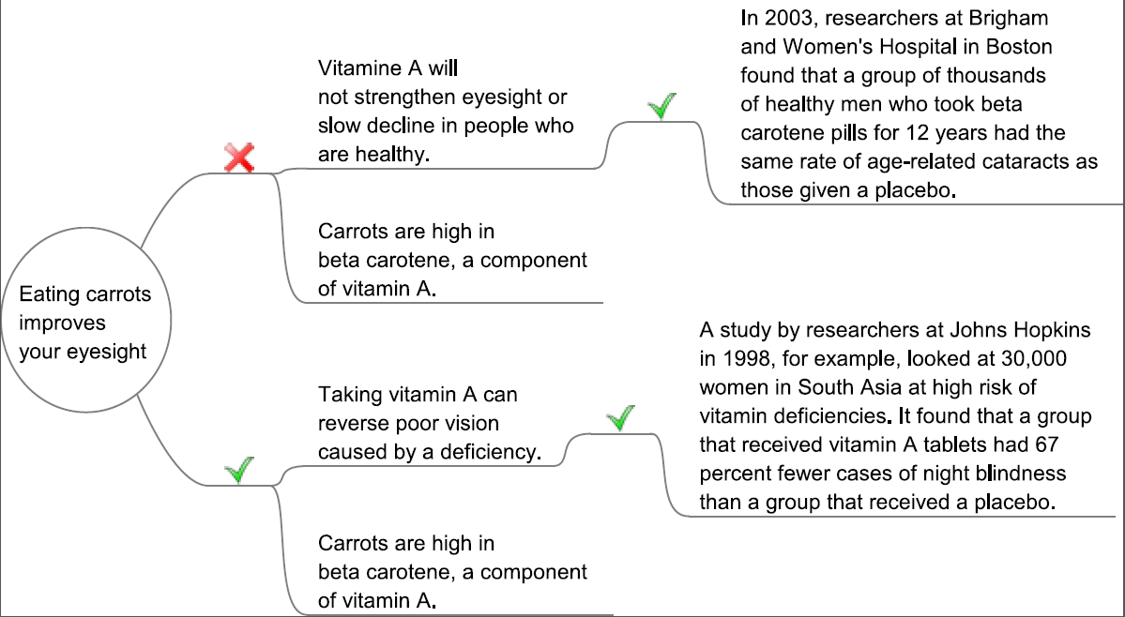
Mapping the arguments - graphical

Slide 16
References
Alvarez, C. (2007) ‘Does philosophy improve critical thinking skills?’, Thesis for the degree of Master of Arts University of Melbourne [Online], Available at https://web.archive.org/web/20120708000509/http://images.austhink.com/pdf/Claudia-Alvarez-thesis.pdf (Accessed 13 October 2020).

